Slide 1
DATABASE ARCHITECTURE
Prof. Chittaranjan Pradhan
School of Computer Engineering,
KIIT University, BBSR

Slide 2
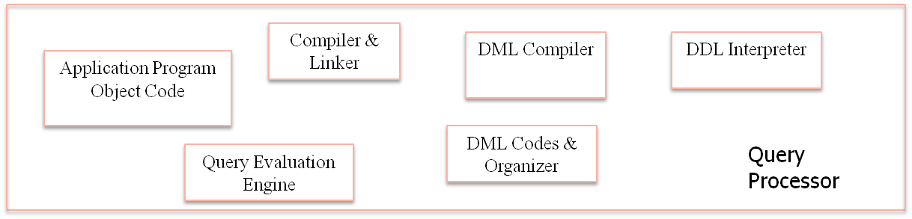
Naïve Users
Application Programmers
Sophisticated Users
DBA
Application Interfaces
Application Programs
Query Tools
Administrative Tools
Buffer Manager
File Manager
Authorization & Integrity Manager
Transaction Manager
Storage Manager
Indices
Data Dictionary
Disk Storage
Data
Statistical Data
Prof. Chittaranjan Pradhan, SCE, KIIT University

